Slide 1
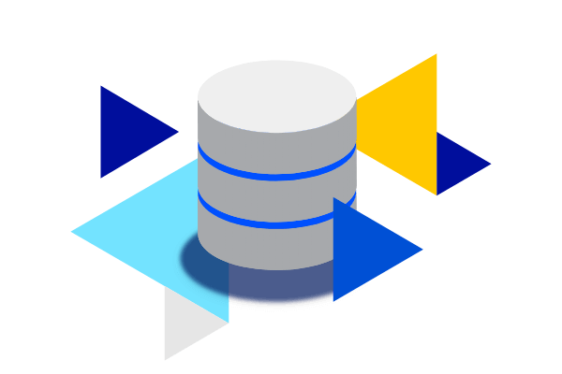
Data Collection and Analysis Using SQL
Presented by:
Hemidov Ceyhun

Slide 2
Introduction
In this presentation, I will show how I collected and analyzed data using SQL.
You will learn about:
1
How I gathered the data
2
How I created data tables in SQL and imported the dataset
3
How I analyzed the data in SQL and drew meaningful conclusions
Without further delay, let’s get started!

Slide 3
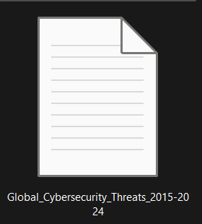
Data Preparation
In this project, we already have a certain dataset.
However, since all of the data is in CSV format, it cannot be directly analyzed in SQL.
Therefore, we need to import this data into the Valentina Studio program to make it ready for analysis.

Slide 4
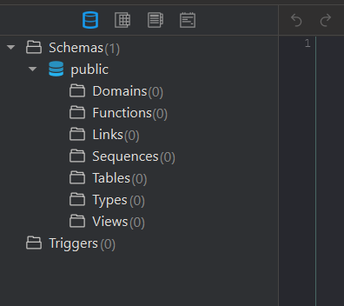
Creating Tables
As you can see here, there are no tables yet.
Therefore, we need to write the SQL code for each table separately and create them one by one.
After creating all the tables, we will be able to perform our analyses on these tables.

Slide 5
Let’s start to create Data table

Slide 6
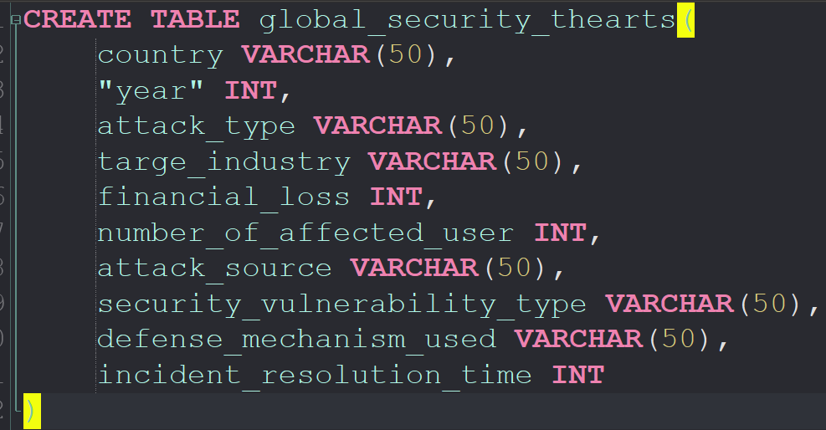
Global cyber security threats
The columns in this dataset describe key details of each cyber incident. They include the country where the attack happened, the year of the event, and the type of cyberattack such as phishing or ransomware. The dataset also shows which industry was targeted, the financial loss in millions of dollars, and the number of affected users. Additional columns provide information about the attack source, the vulnerability that allowed the attack, and the defense mechanism used by the organization. Finally, the incident resolution time column shows how many hours were needed to fully handle the attack.
Overall, this dataset presents a clear view of global cybersecurity threats from 2015 to 2024. It highlights different attack patterns across countries, industries, and years, allowing us to identify trends and high-risk areas. The data helps analyze which attack types cause the most damage, which industries face the highest exposure, and how effectively incidents are resolved. This makes the dataset useful for security analysis, risk assessment, and developing stronger cyber defense strategies.

Slide 7
Now Let’s start to analyze this data

Slide 8
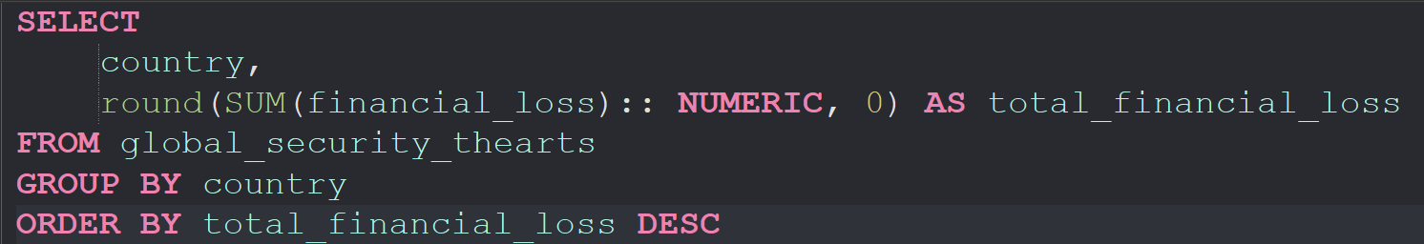
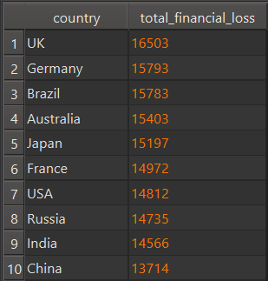
The countries that experienced the highest number of attacks.
From this chart, we can see that the UK has the highest financial loss, with a total of 16,503 M dollars. It is followed by Germany, Brazil, and Australia. All 10 countries are shown here. This also shows that the difference between the country with the maximum loss and the one with the minimum loss is quite small. However, the amount of loss still reflects how strong or weak each country is in terms of cybersecurity

Slide 9
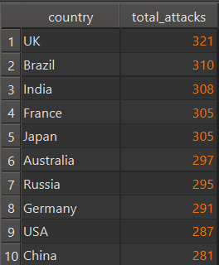
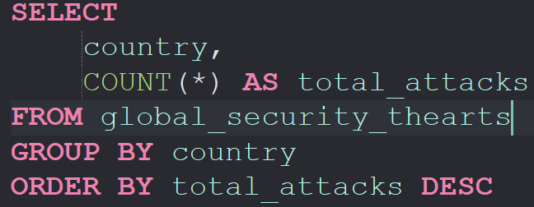
Countries with the highest number of cyberattacks
When we compare both charts, we can see that the UK is ranked first in both categories: it has the highest number of cyberattacks and also the highest total financial loss. This shows that the UK is one of the main targets for cybercriminals. Countries like Brazil, India, France, and Japan also appear near the top in both lists, which means they face frequent attacks and suffer major financial damage. Overall, there is a clear connection: countries that experience more attacks also tend to lose more money. This suggests that the volume of attacks strongly affects the financial impact of cyber incidents.

Slide 10
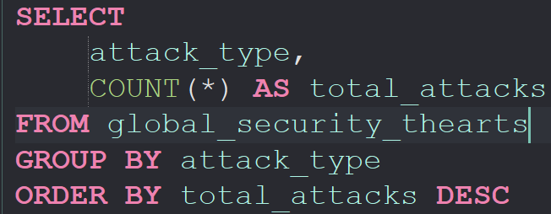
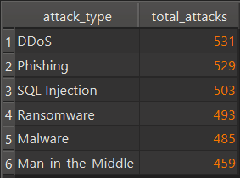
Attack Type Distribution
The results show that DDoS attacks are the most common, with 531 cases. Phishing is the second most frequent attack type with 529 incidents, which is almost the same as DDoS. SQL Injection and Ransomware also appear very often, showing that both application-level and data-focused attacks are major problems. Malware and Man-in-the-Middle attacks have slightly lower numbers but are still significant. Overall, the distribution shows that all six attack types are widely used, and the difference between them is not very large, meaning organizations must be ready for many different types of threats.

Slide 11
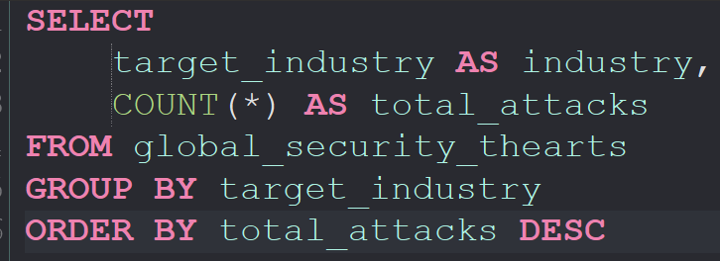
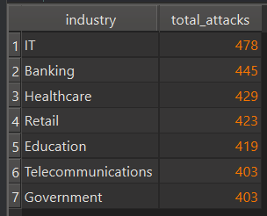
Industry Risk Ranking
The results show that the IT sector is the most targeted industry, with 478 attacks. Banking is the second most affected sector, followed by Healthcare and Retail. Education, Telecommunications, and Government also face a high number of attacks, but their values are slightly lower. Overall, the data shows that almost all major industries are under serious cyber risk, and the difference between them is not very large. This means attackers focus on many sectors, not just one specific area.

Slide 12
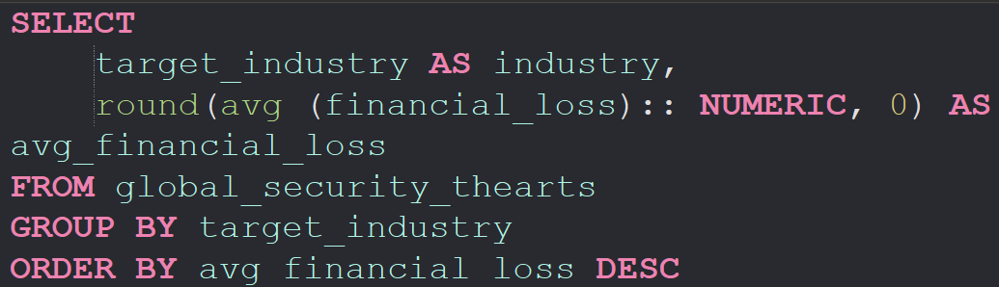
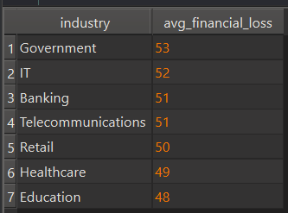
Average Financial Loss by Industry
When we compare the two charts, we see that IT, Banking, and Healthcare get the highest number of attacks. However, the Government sector has the highest average financial loss, even though it has fewer attacks. This means attacks on Government systems are less common but more damaging. On the other hand, sectors like IT and Banking face many attacks but lose slightly less money per incident. Overall, some industries are attacked more often, while others suffer more expensive attacks.

Slide 13
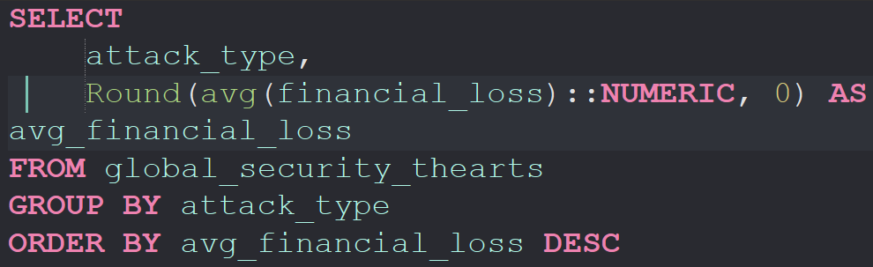
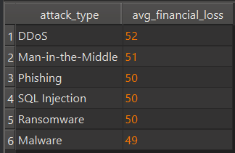
Average Financial Loss by Attack Type
The results show that DDoS attacks cause the highest average financial loss with 52 million dollars. Man-in-the-Middle attacks are the second most expensive with 51 million. Phishing, SQL Injection, and Ransomware all have an average loss of about 50 million dollars, while Malware has the lowest loss at 49 million. Overall, the differences between attack types are very small, which means all cyberattacks can cause serious financial damage.

Slide 14
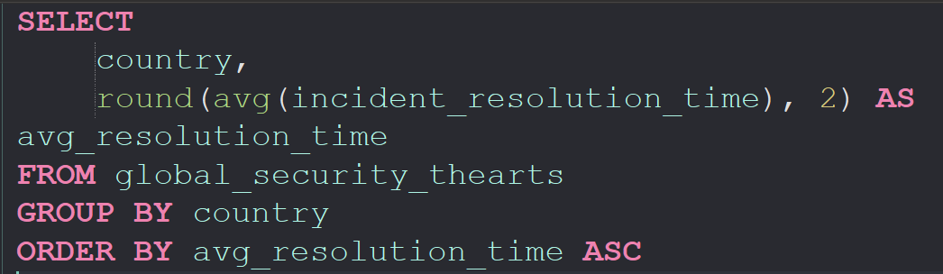
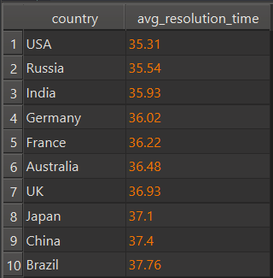
Average Resolution Time by Country
The results show that the USA, Russia, and India have the fastest resolution times, which means they are the most efficient at handling cyber incidents. Germany, France, and Australia are in the middle range, while the UK, Japan, China, and Brazil take longer to resolve attacks. Overall, countries with faster resolution times likely have stronger security teams and better response systems, while slower countries may need improvements in their incident management process.

Slide 15
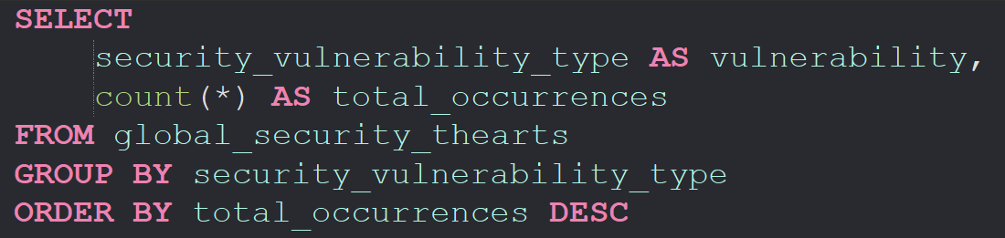
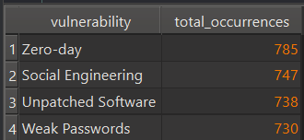
Vulnerability Type Frequency
The results show that Zero-day vulnerabilities are the most common, appearing 785 times. Social Engineering is the second most frequent, followed by Unpatched Software and Weak Passwords. This means attackers often take advantage of unknown security flaws and human mistakes. Technical weaknesses like missing updates or poor passwords are also major risk factors. Overall, all four vulnerability types are widely used by attackers, and organizations must address both human and technical weaknesses to reduce cyber risks.

Slide 16
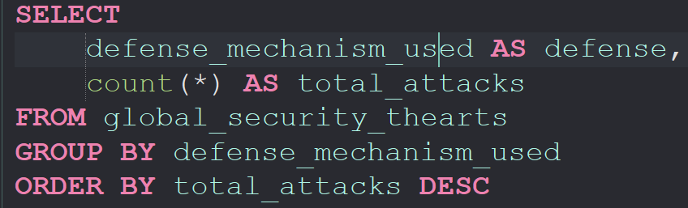
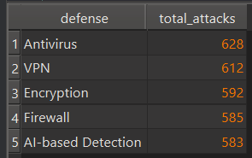
Defense Mechanism Effectiveness
The results show that attacks are most successful against systems that use Antivirus and VPN protection, with 628 and 612 incidents. Encryption and Firewall also face a high number of successful attacks, while AI-based Detection has the lowest number but still remains significant. This means that traditional security tools like Antivirus, VPN, and Firewall are not always strong enough to stop modern cyberattacks. Even advanced systems like AI detection cannot fully prevent them. Overall, all defense mechanisms can be bypassed if attackers use more advanced techniques.

Slide 17
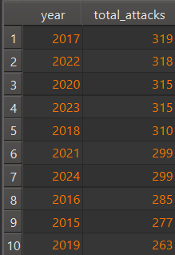
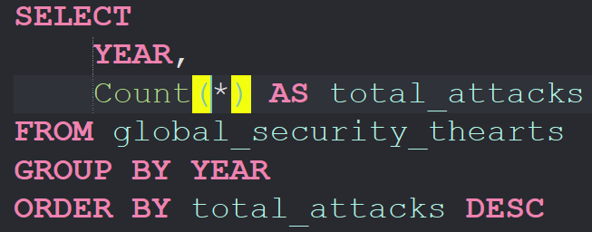
Year-on-Year Attack Trends
The results show that cyberattacks do not follow a simple increasing or decreasing pattern. From 2015 to 2017, the number of attacks rises steadily and reaches its highest point in 2017. After that, the numbers stay mostly stable, with small ups and downs between 2018 and 2024. The lowest value is in 2019, while 2020–2023 remain in a similar range. Overall, the trend is fairly stable with slight fluctuations, meaning cyber threats remain consistently high each year.

Slide 18
Overall Conclusion
Overall, our analysis shows that cyberattacks are a serious problem for almost all countries and industries. The UK is the most affected country in both attack count and financial loss. IT and Banking face the highest number of attacks, but Government has the highest average loss per incident, which was surprising. We also saw that different attack types cause almost the same amount of damage, and there is almost no connection between affected users and financial loss. Some countries, like the USA and Russia, solve incidents faster, while others need more time. Common weaknesses such as Zero-day flaws and Social Engineering appear very often, and even strong defense tools like Antivirus or VPN are not always enough. This shows that organizations must improve both technical security and response skills.

Slide 19
Thank you for your attention!

